Slide 1

Mastering Functions in Linux
1
Functions

Slide 2

Power up your scripts with functions!
2
Functions

Slide 3
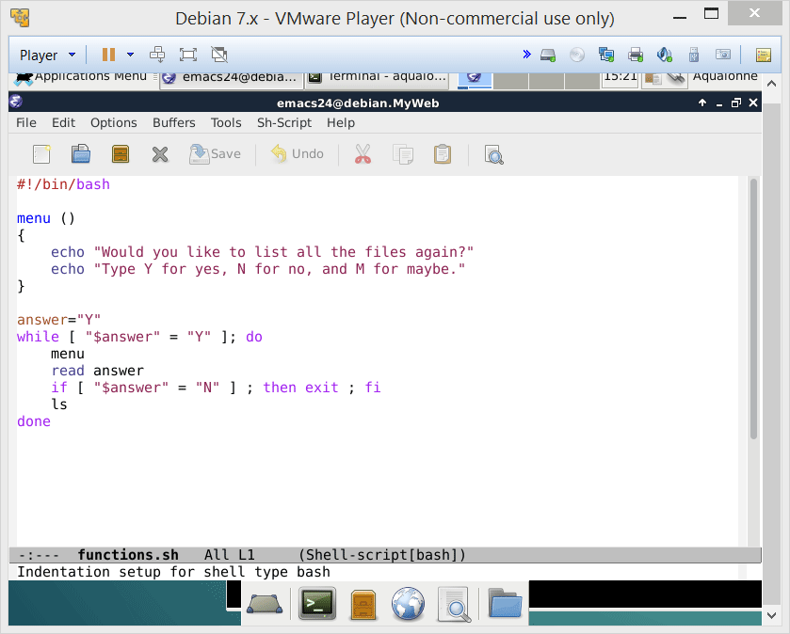
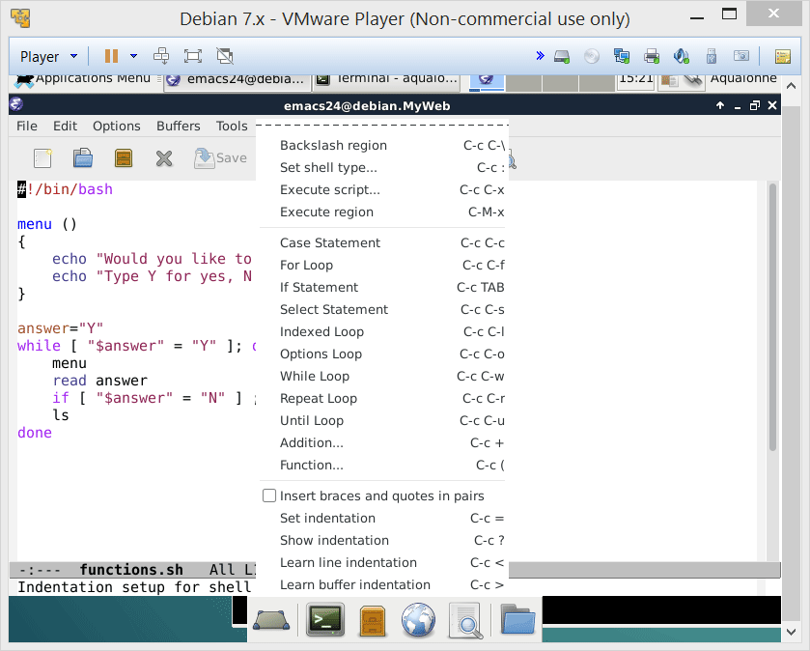
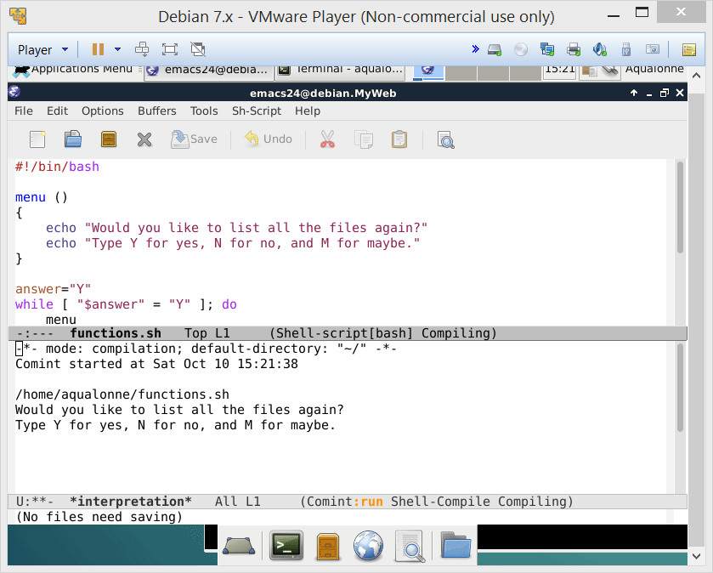

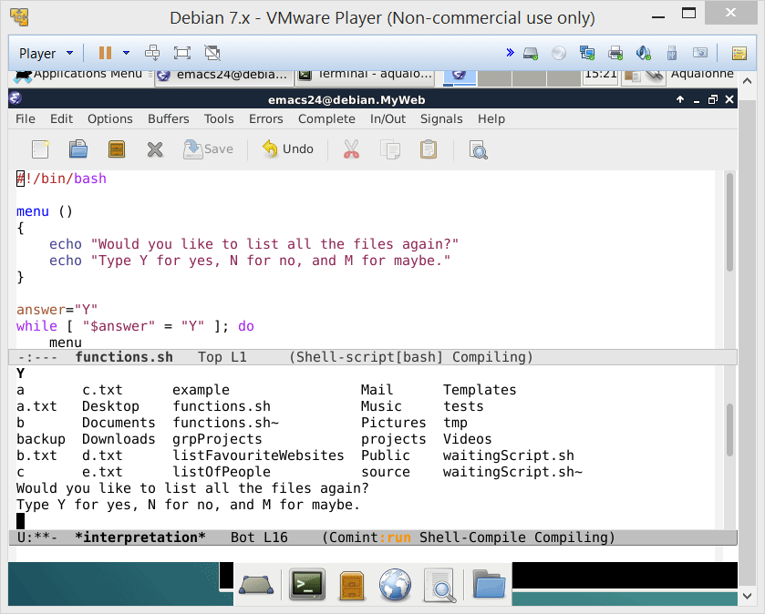
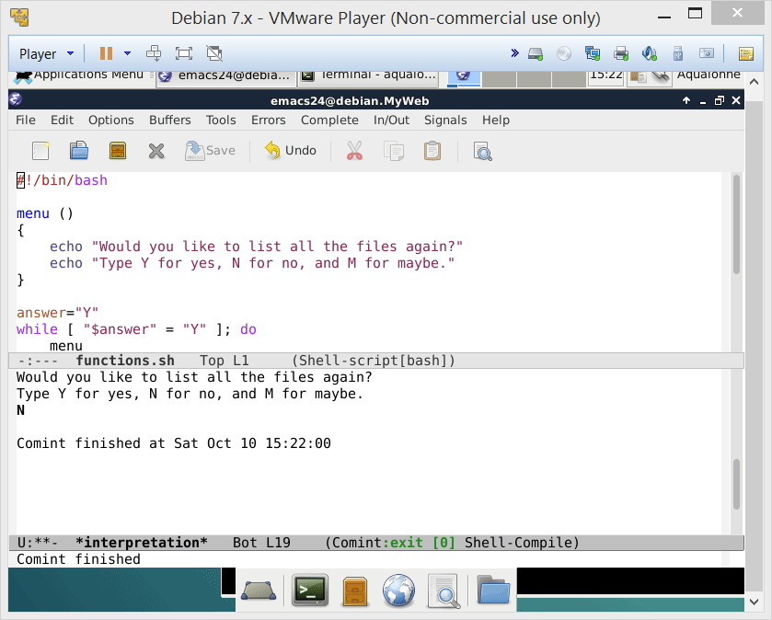
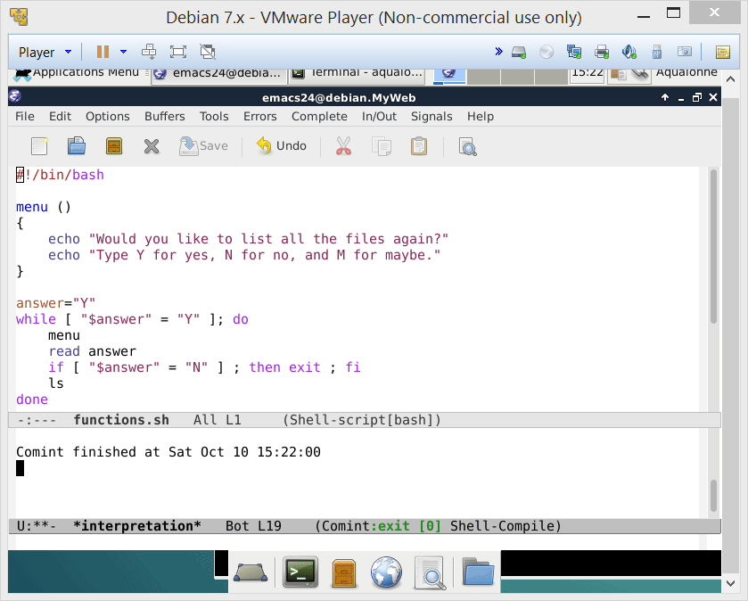
Power up your scripts with functions!
To make a function:
nameOfFunction ( )
{
... content ...
}
After it’s been made, you call it like a command.
3
Functions

Slide 4
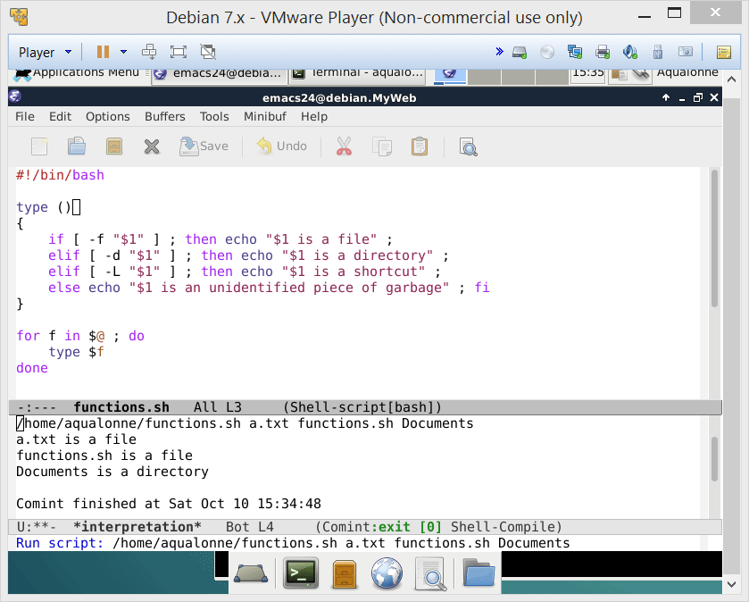
Power up your scripts with functions!
You can pass arguments to a function, and they will be accessed as $1, ...
Note that $0 is always the name of the script! For the function’s name:
${FUNCNAME[0]}
4
Functions

Slide 5
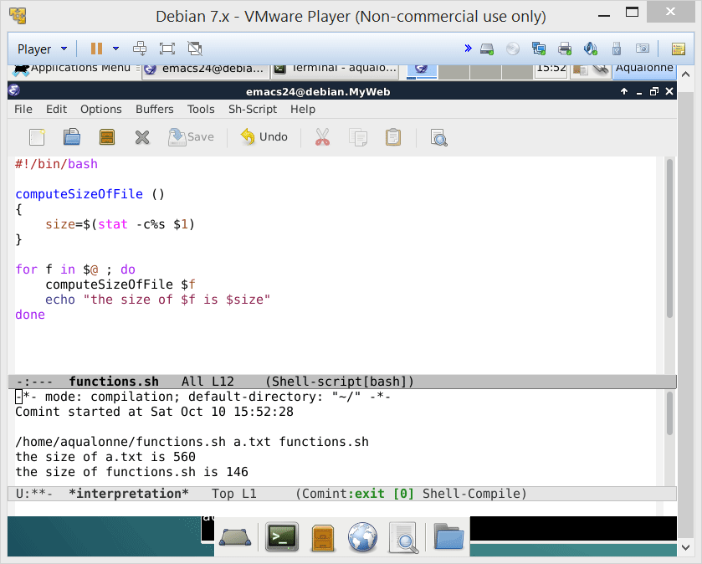

Power up your scripts with functions!
Variables made in a function are accessible in the whole script.
Do not use return to get variables’ values back!
For values
5
Functions

Slide 6
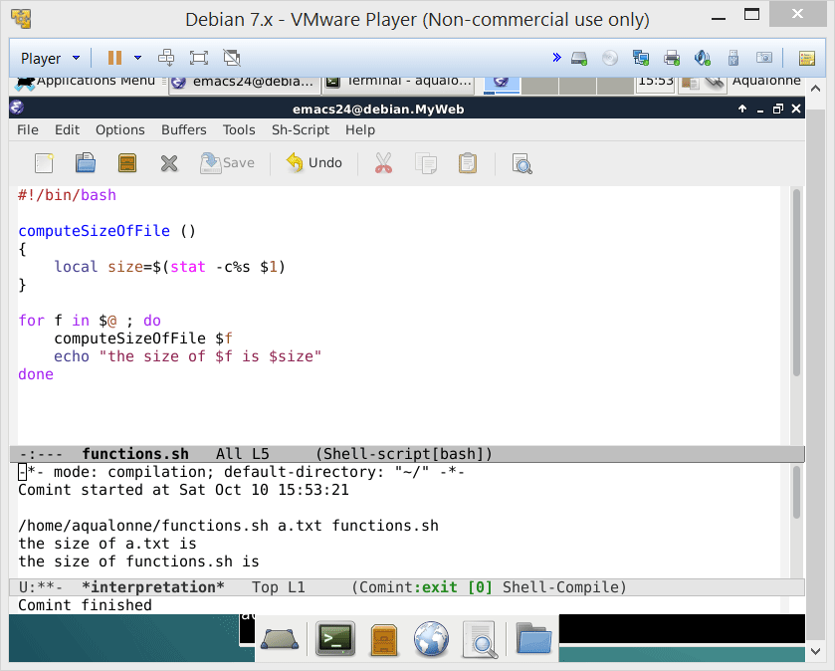
Power up your scripts with functions!
If you do not want a variable made in a function to be accessible:
local
When do you think that it would be useful?
For really temporary variables, e.g. index i for a loop...
6
Functions

Slide 7
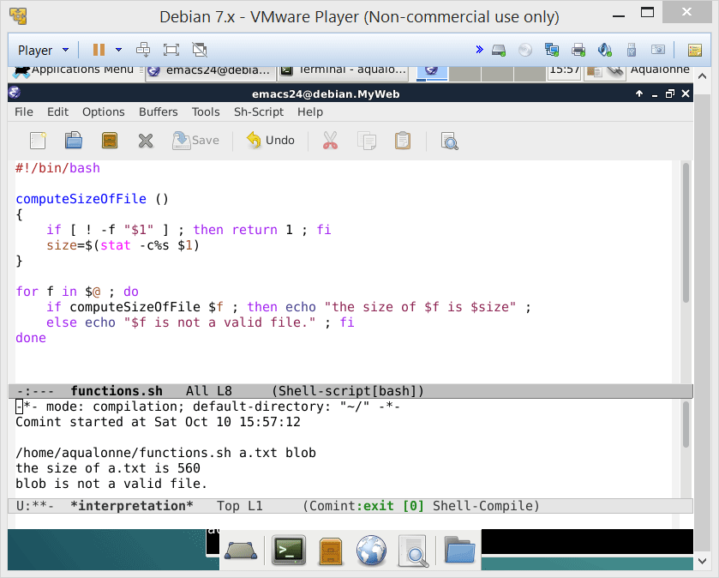
Power up your scripts with functions!
return is used only to end a function and give a status
0 for success
1 for fail
7
Functions

Slide 8
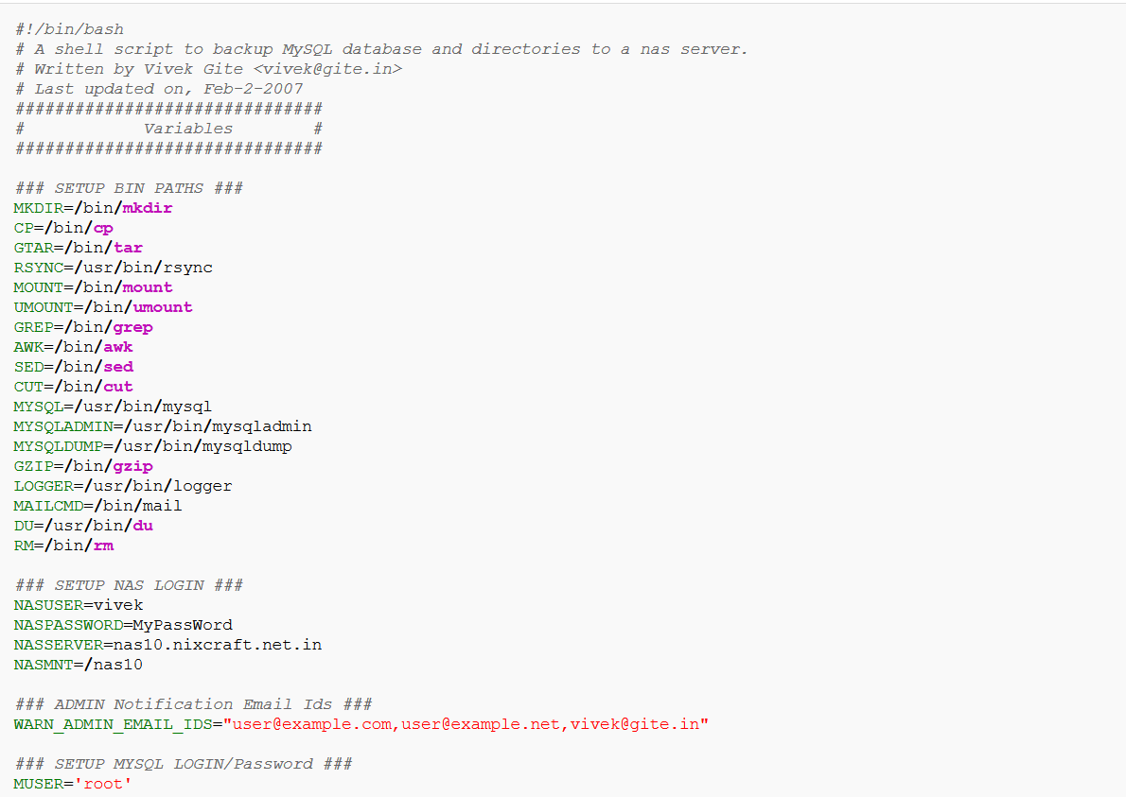
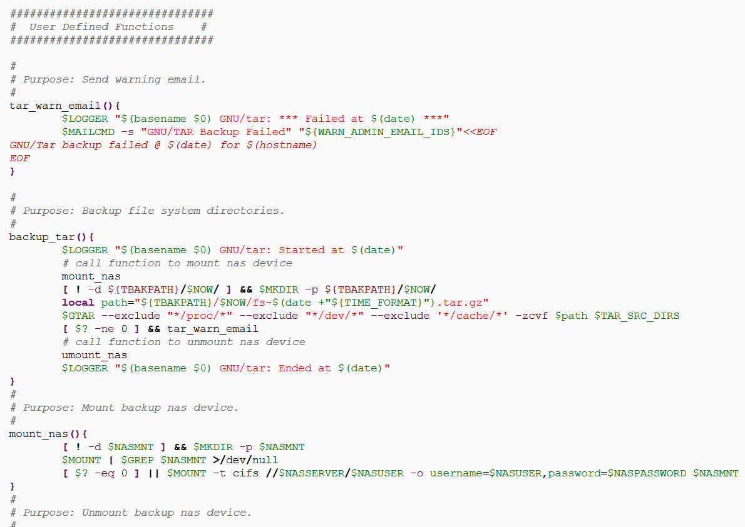
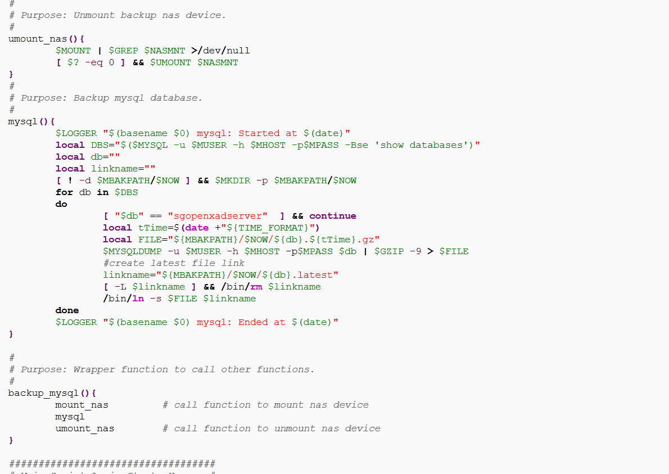
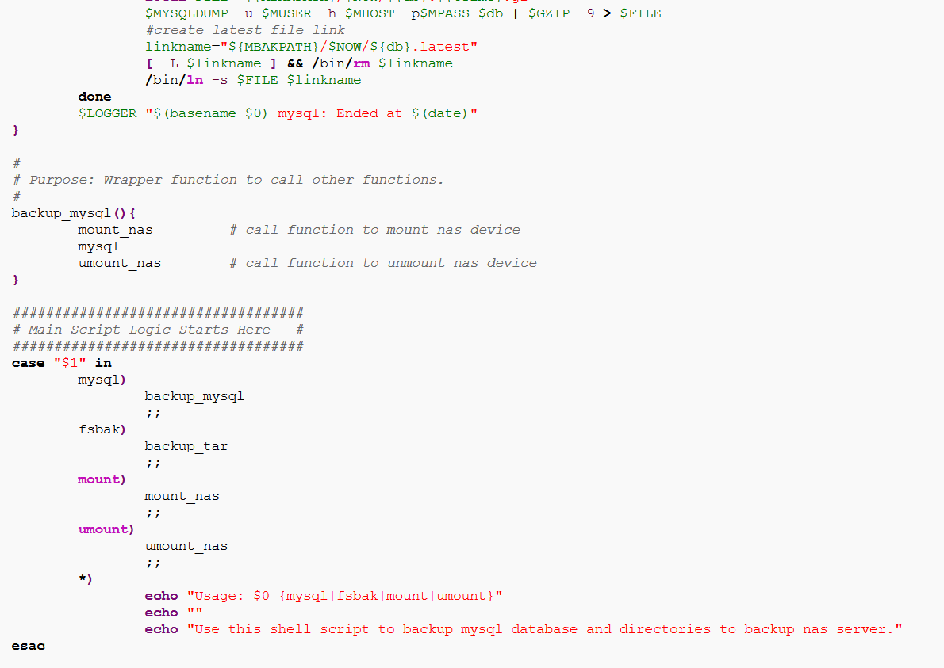
Here is what a good real-world script looks like.
8
Functions

Slide 9

When we see a well-organized script, we expect to just start it and then all pieces work well!
9
Functions

Slide 10

Let’s try writing some functions too!
10
Functions

Slide 11
Let’s try writing some functions too!
Ask the user for his/her income, and give the corresponding tax bracket.
< 9226 is 10%
9226 to 37450 is 15%
37451 to 90750 is 25%
90751 to 189300 is 28%
189301 to 411500 is 33%
411501 to 413200 is 35%
> 413200 is 39.6%
Do not use functions for your first solution.
11
Functions

Slide 12
Let’s try writing some functions too!
#!/bin/bash
read -p "Please enter your annual income: " income
if [ "$income" -eq "$income" 2> /dev/null ]
then
if [ "$income" -ge "0" ] && [ "$income" -le "9225" ]
then
echo -e "\nYou are in the 1st tax bracket, which has a marginal tax rate of 10%.\n"
elif [ "$income" -ge "9226" ] && [ "$income" -le "37450" ]
then
echo -e "\nYou are in the 2nd tax bracket, which has a marginal tax rate of 15%.\n"
elif [ "$income" -ge "37451" ] && [ "$income" -le "90750" ]
then
echo -e "\nYou are in the 3rd tax bracket, which has a marginal tax rate of 25%.\n"
elif [ "$income" -ge "90751" ] && [ "$income" -le "189300" ]
then
echo -e "\nYou are in the 4th tax bracket, which has a marginal tax rate of 28%.\n"
elif [ "$income" -ge "189301" ] && [ "$income" -le "411500" ]
then
echo -e "\nYou are in the 5th tax bracket, which has a marginal tax rate of 33%.\n"
elif [ "$income" -ge "411501" ] && [ "$income" -le "413200" ]
then
echo -e "\nYou are in the 6th tax bracket, which has a marginal tax rate of 35%.\n"
elif [ "$income" -ge "413201" ]
then
echo -e "\nYou are in the 7th tax bracket, which has a marginal tax rate of 39.6%.\n"
fi
else
echo -e "\nYou did not enter a valid income.\n"
fi
12
Functions

Slide 13
Let’s try writing some functions too!
Rewrite this part as a function named showBracket which takes as argument the upper end of each tax bracket, and the user’s income.
if [ "$income" -ge "0" ] && [ "$income" -le "9225" ]
then
echo -e "\nYou are in the 1st tax bracket, which has a marginal tax rate of 10%.\n"
elif [ "$income" -le "37450" ]
then
echo -e "\nYou are in the 2nd tax bracket, which has a marginal tax rate of 15%.\n"
elif [ "$income" -le "90750" ]
then
echo -e "\nYou are in the 3rd tax bracket, which has a marginal tax rate of 25%.\n"
elif [ "$income" -le "189300" ]
then
echo -e "\nYou are in the 4th tax bracket, which has a marginal tax rate of 28%.\n"
elif [ "$income" -le "411500" ]
then
echo -e "\nYou are in the 5th tax bracket, which has a marginal tax rate of 33%.\n"
elif [ "$income" -le "413200" ]
then
echo -e "\nYou are in the 6th tax bracket, which has a marginal tax rate of 35%.\n"
else
then
echo -e "\nYou are in the 7th tax bracket, which has a marginal tax rate of 39.6%.\n"
fi
13
Functions

Slide 14
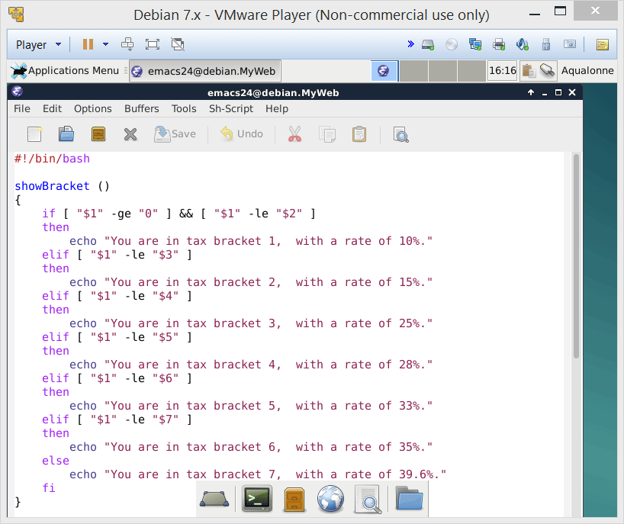
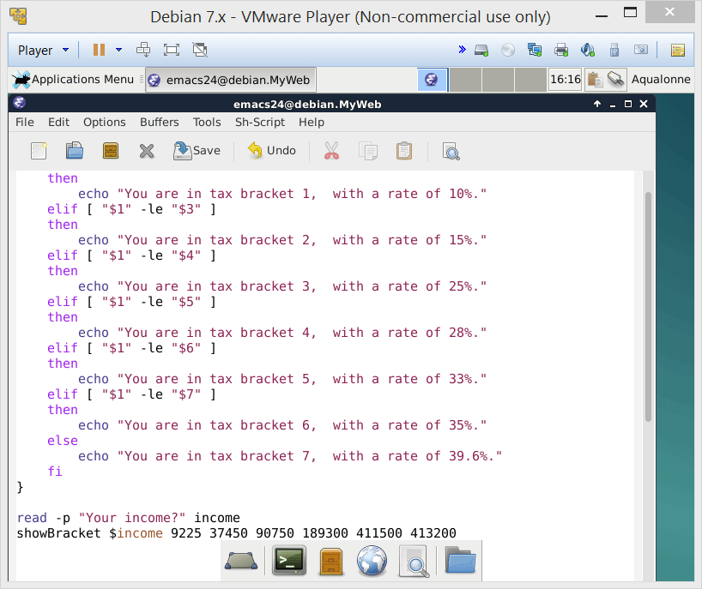
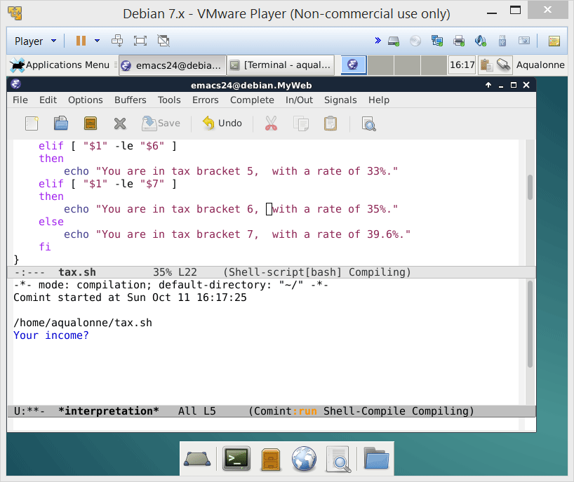
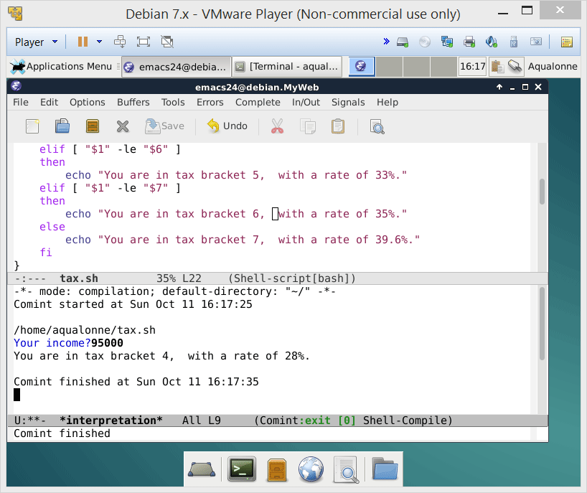
Let’s try writing some functions too!
In reality, there is a different tax rate based on whether one is single, married, etc.
How would you change that code so it works with the different tax rates?
14
Functions

Slide 15
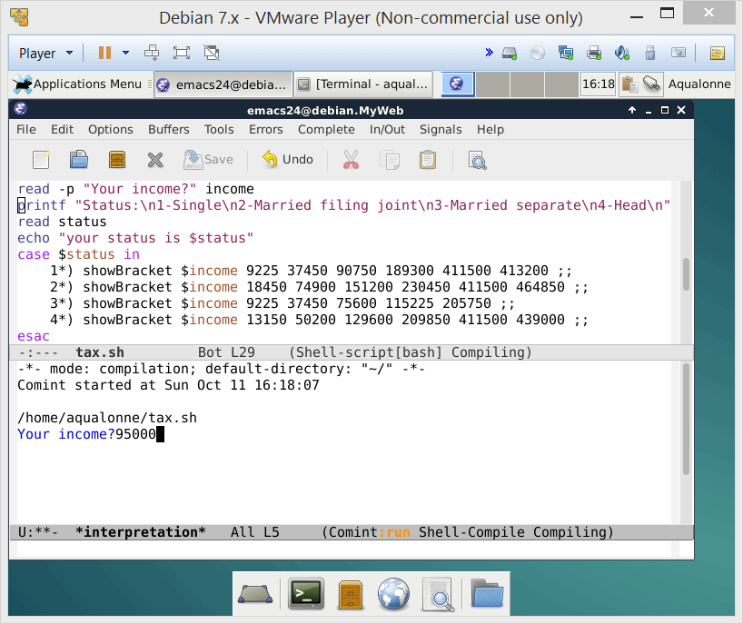

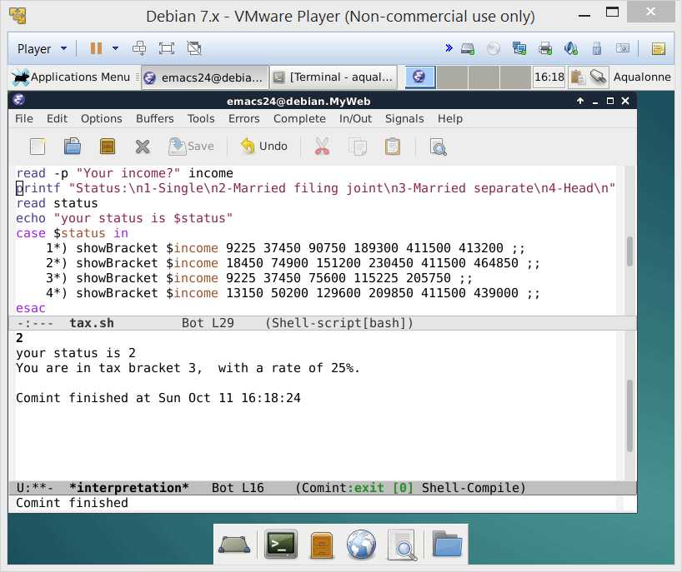
Let’s try writing some functions too!
In reality, there is a different tax rate based on whether one is single, married, etc.
How would you change that code so it works with the different tax rates?
15
Functions

Slide 16
Let’s try writing some functions too!
How can you make it shorter?
16
Functions

Slide 17
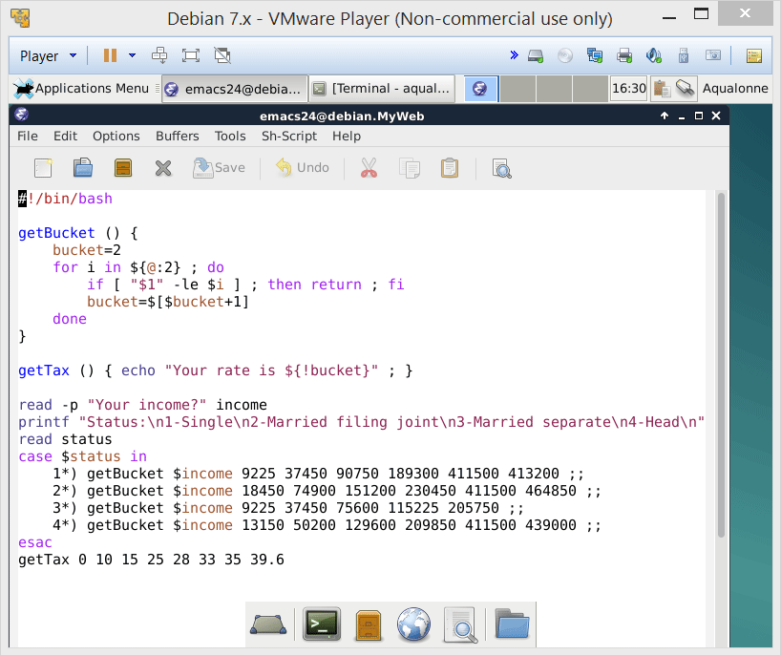

Let’s try writing some functions too!
How can you make it shorter?
17
Functions

Slide 18
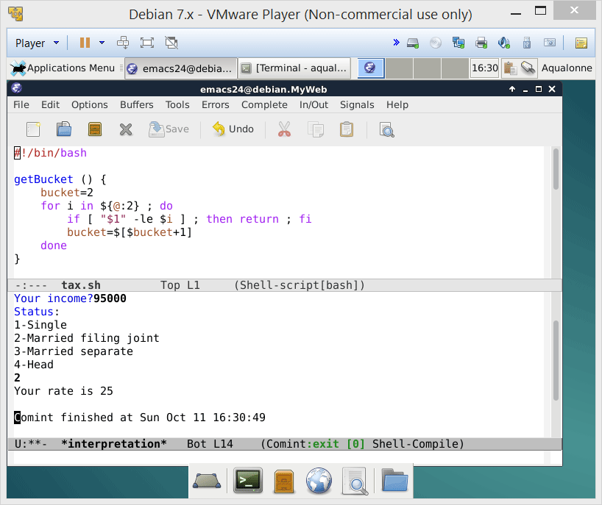
Let’s try writing some functions too!
How can you make it shorter?
18
Functions

Slide 19

How some people use functions…
19
Functions

Slide 20

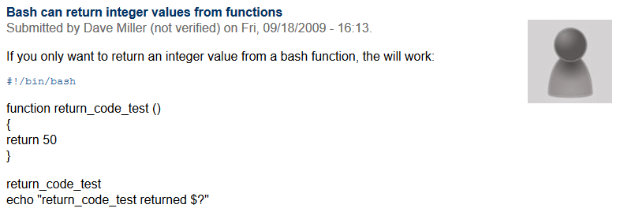
How some people use functions…
Paid limited attention in class
Has to write a function that computes a file’s size
Checks on google how to do it...
Comes across this...
20
Functions

Slide 21
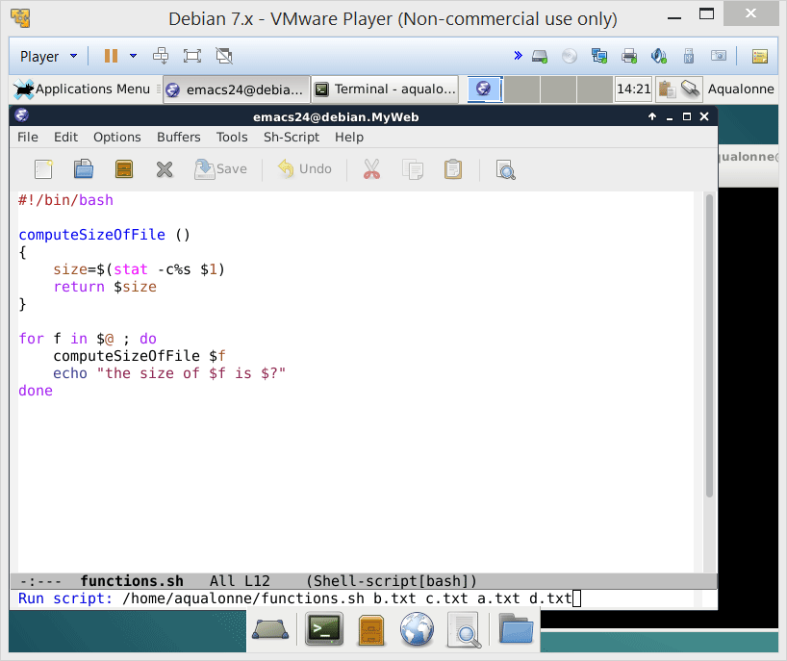
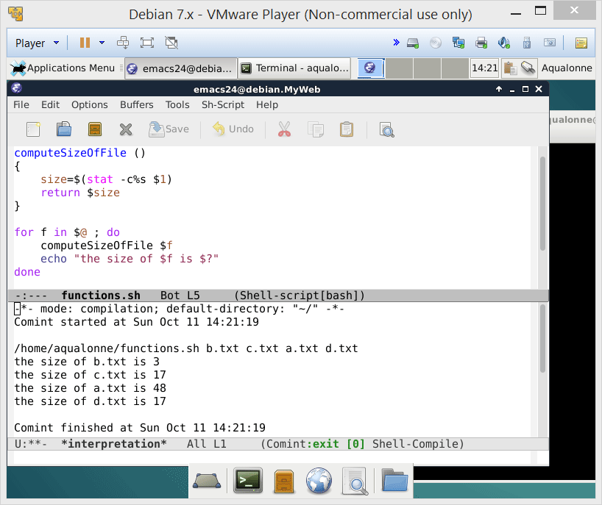
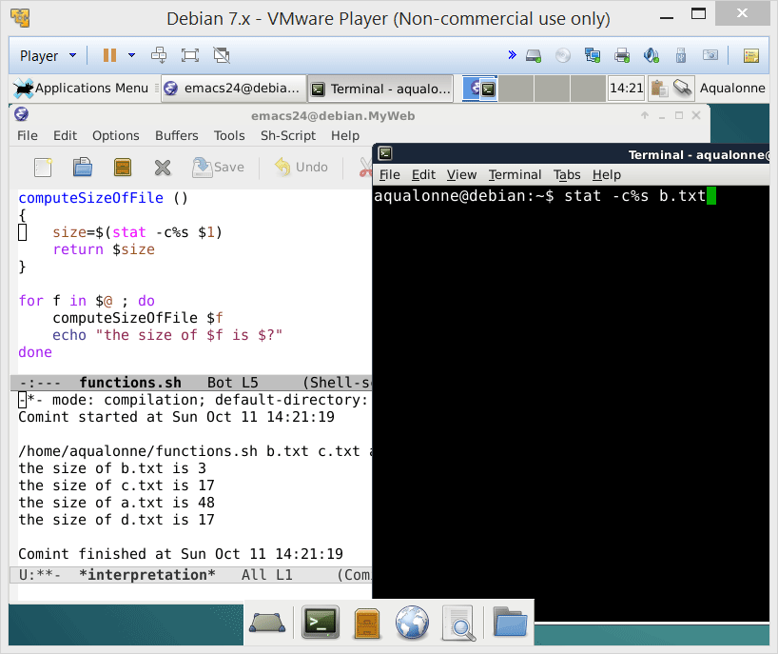
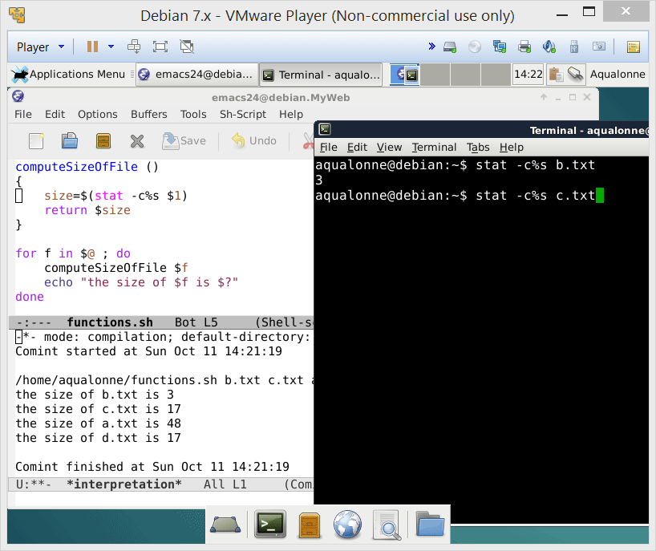
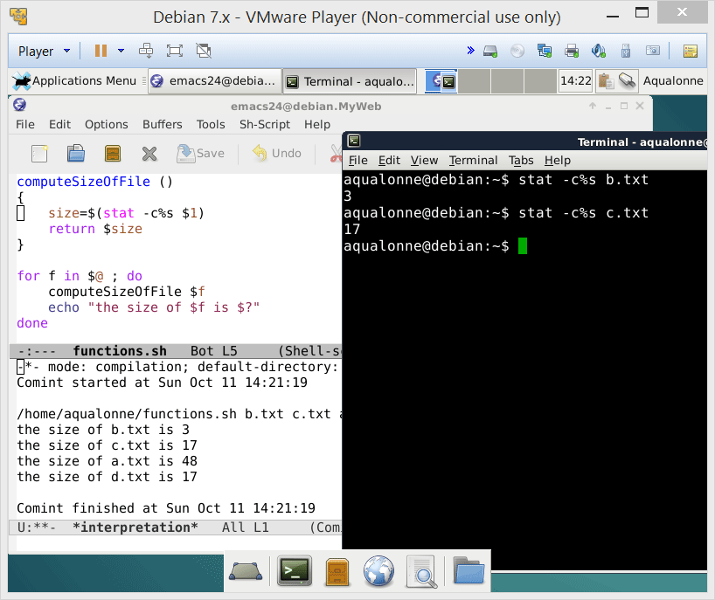

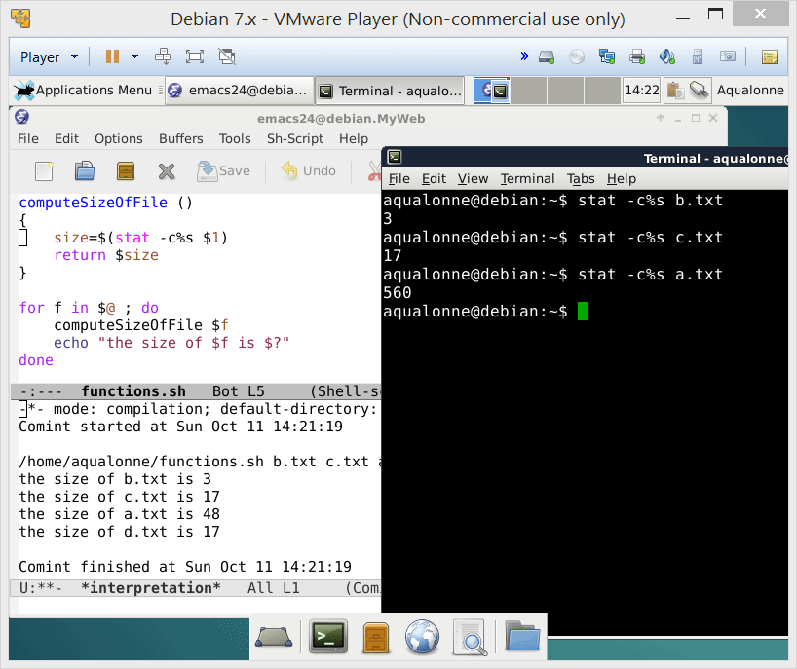
How some people use functions…
return is not to return results of functions, and not to return any integer
return gives an exit status which goes from 0 to 255, with 0 and 1 being common
21
Functions

Slide 22

How some people use functions…
How to treat programmers who write code like that
22
Functions

Slide 23
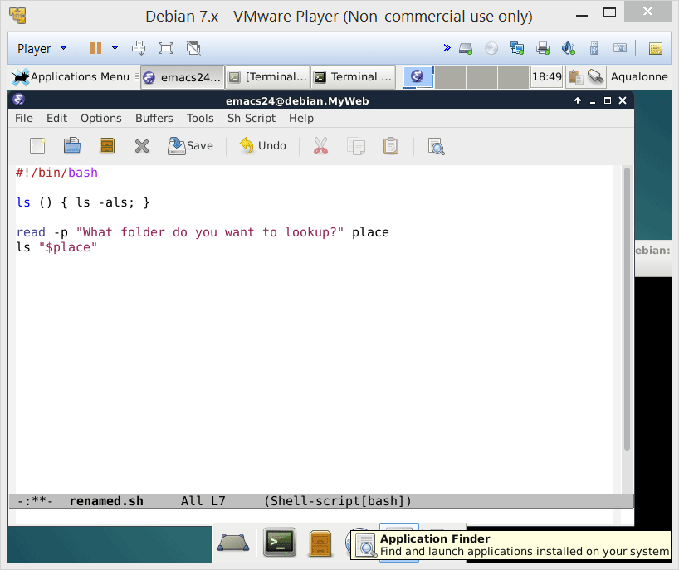
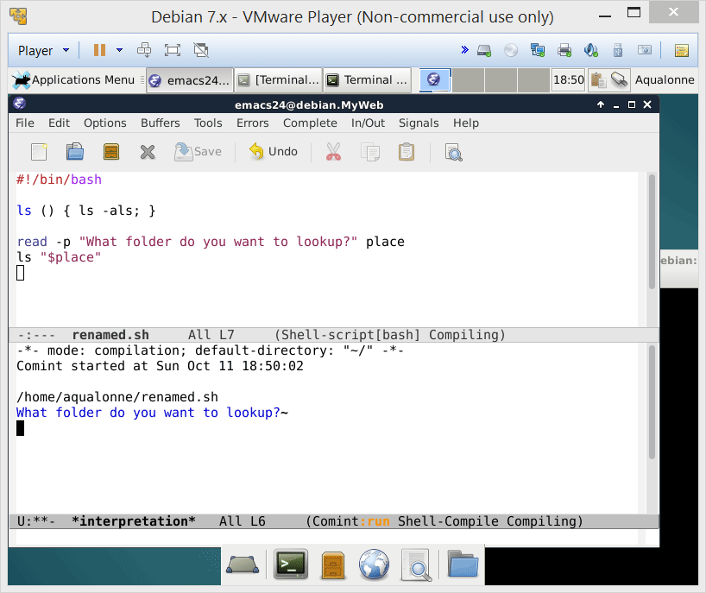
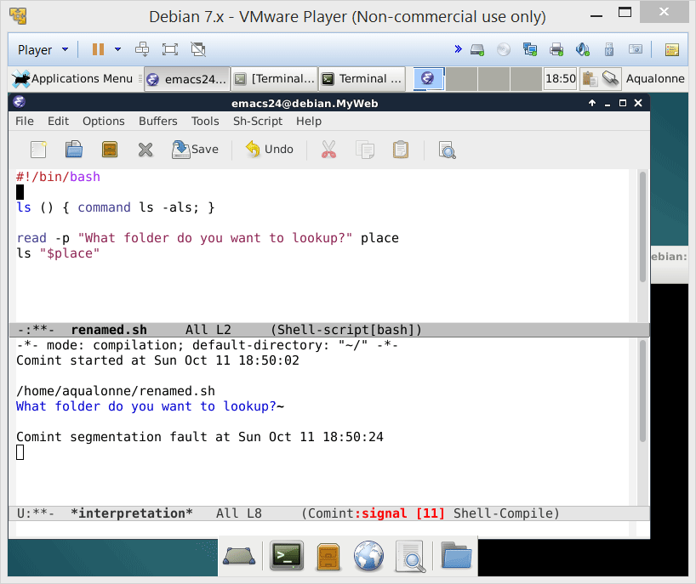
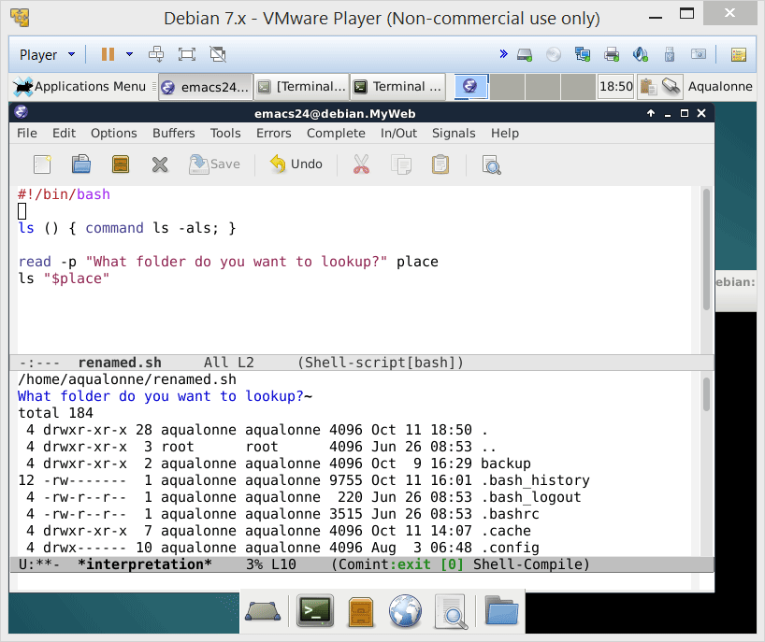

How some people use functions…
If you want to overload a command, then you need to use the command keyword
3 hours later...
23
Functions

Slide 24
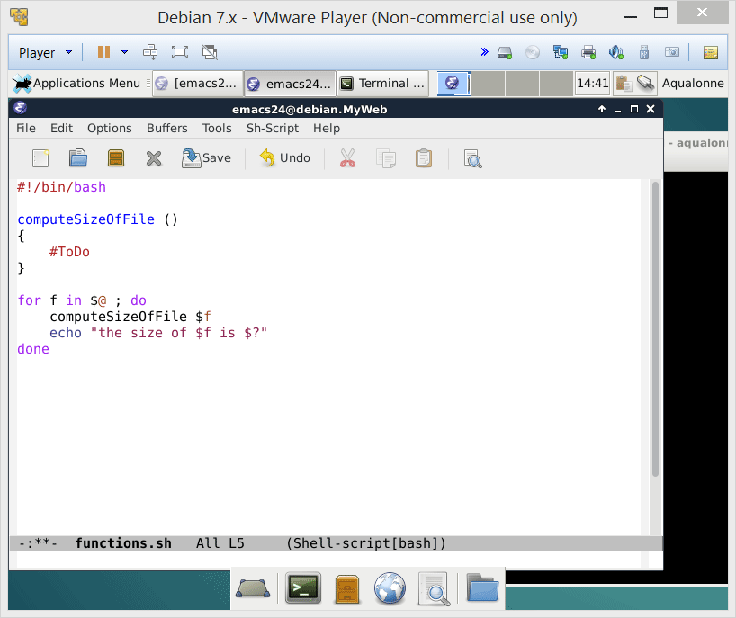
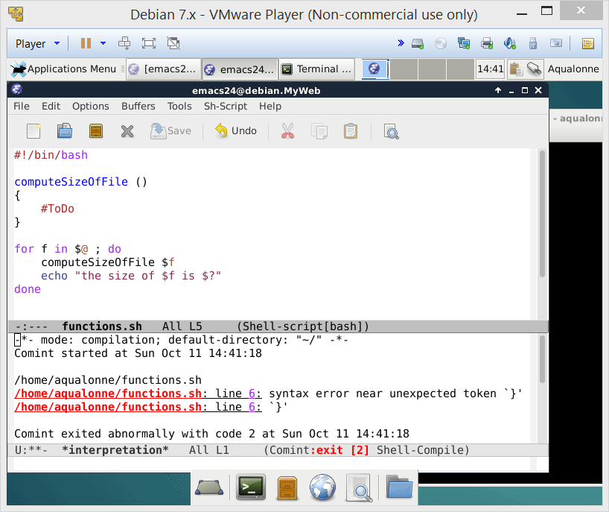
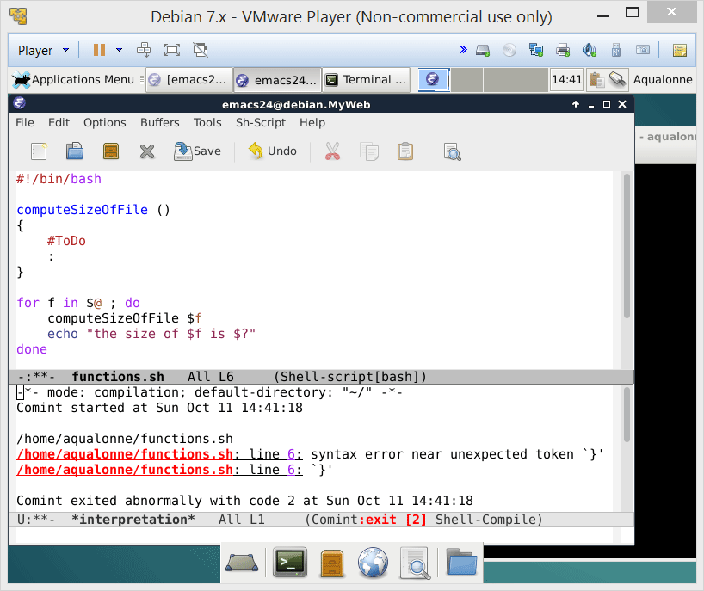

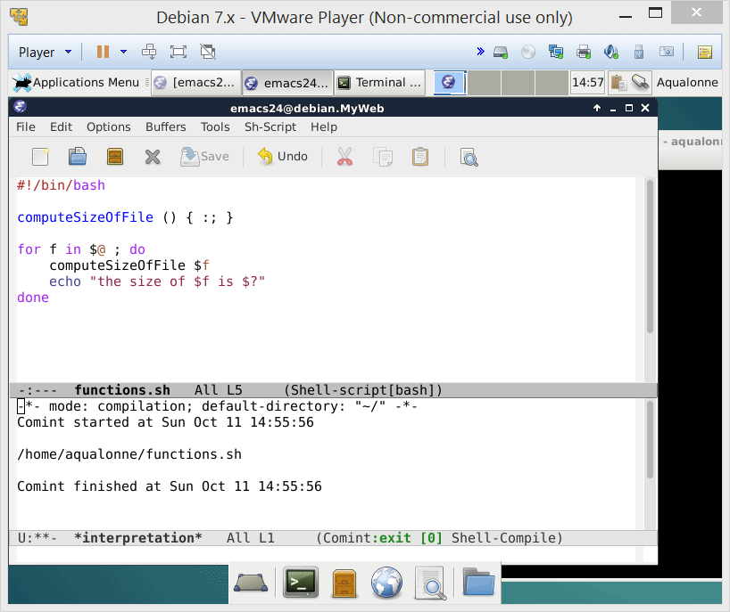
How some people use functions…
A function must contain at least one instruction.
: is the do-nothing instruction
If a function is a one liner, commands must be ; separated with a final ;
24
Functions

Slide 25
How some people use functions…
This is a valid function... It will run!
:(){ :|: & };:
25
Functions

Slide 26

How some people use functions…
This is a valid function... It will run!
:(){ :|: & };:
This is how we feel when looking at code like that.
26
Functions

Slide 27
How some people use functions…
What do you think it does?
:(){ :|: & };:
creates a function named :
detach
Call the function
Run the function itself
...the function itself
Once it’s done, send the result to...
27
Functions

Slide 28
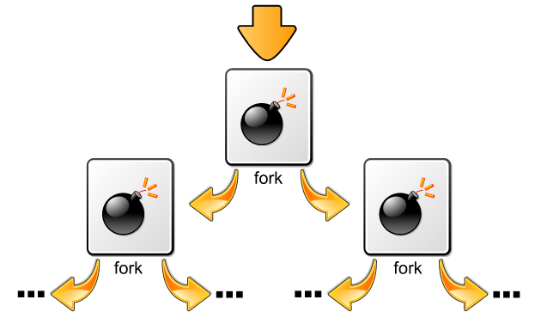

How some people use functions…
What do you think it does?
:(){ :|: & };:
If you want to know, just have a look at Fork bomb on Wikipedia!
28
Functions

Slide 29

29
Functions

Slide 30

Practice questions & activities
We recommend that you do these, but that’s for your own good, not graded.
We created a function ls in a script so that the default behaviour of the ls command was changed. Another way to do this is to use aliases. Read the following page and create an alias so that ls does ls –als:
http://tldp.org/LDP/abs/html/aliases.html
Write a function named isInList which takes as arguments a number followed by a set of at least one other number. It shows ‘true’ if the number is in the list and ‘false’ otherwise.
Write a function named weightedSum. It can take any number of arguments but they are expected to come in pairs a1 b1 a2 b2 ... an bn. It computes the weighted sum a1*b1 + a2*b2 + ... + an*bn. For example, if we wrote
weightedSum 2 5 3 1 4 5
we would get 33 because 2*5+3*1+4*5=33.
30
Functions

Slide 31
To go beyond…
Ask the user for his/her income, and give the corresponding tax bracket.
< 9226 is 10%
9226 to 37450 is 15%
37451 to 90750 is 25%
90751 to 189300 is 28%
189301 to 411500 is 33%
411501 to 413200 is 35%
> 413200 is 39.6%
Let’s look at a solution using a Matrix data structure in Bash script.
(unnecessarily complex because functions are a better design, but nonetheless interesting to illustrate matrices ☺ )
31
Functions

Slide 32

To go beyond…
#!/bin/bash
#Ask user for taxable income and filing status
declare -i income; declare -i fileStatus
clear
printf "1) Single \n2) Married filing joint or Qualified Widow(er) \n3) Married filing separate \n4) Head of household \n"
read -p "How will you be filing taxes for 2015?(1-4): " fileStatus
case $fileStatus in
[1-4]) read -p "What was your 2015 taxable income?: " income ;;
*) echo "Not a valid response, must pick 1-4" && exit;;
esac
#Build matrix of tax brackets
declare -A matrix; num_rows=6; num_columns=4
matrix[0,0]=9225; matrix[0,1]=37450; matrix[0,2]=90750; matrix[0,3]=189300; matrix[0,4]=411500; matrix[0,5]=413200
matrix[1,0]=18450; matrix[1,1]=74900; matrix[1,2]=151200; matrix[1,3]=230450; matrix[1,4]=411500; matrix[1,5]=464850
matrix[2,0]=9225; matrix[2,1]=37450; matrix[2,2]=75600; matrix[2,3]=115225; matrix[2,4]=205750; matrix[2,5]=232425
matrix[3,0]=13150; matrix[3,1]=50200; matrix[3,2]=129600; matrix[3,3]=209850; matrix[3,4]=411500; matrix[3,5]=439000
Part 1 of 2
32
Functions

Slide 33
To go beyond…
#Interpret status and compare income to brackets
fileStatus=$((fileStatus-1))
if [ "$income" -le "${matrix[$fileStatus,0]}" ]
then
echo "Your tax rate is 10%"
elif [ "$income" -le "${matrix[$fileStatus,1]}" ]
then
echo "Your tax rate is 15%"
elif [ "$income" -le "${matrix[$fileStatus,2]}" ]
then
echo "Your tax rate is 25%"
elif [ "$income" -le "${matrix[$fileStatus,3]}" ]
then
echo "Your tax rate is 28%"
elif [ "$income" -le "${matrix[$fileStatus,4]}" ]
then
echo "Your tax rate is 33%"
elif [ "$income" -le "${matrix[$fileStatus,5]}" ]
then
echo "Your tax rate is 35%"
else
echo "Your tax rate is 39.6%"
fi
Part 2 of 2
33
Functions

